Slide 1
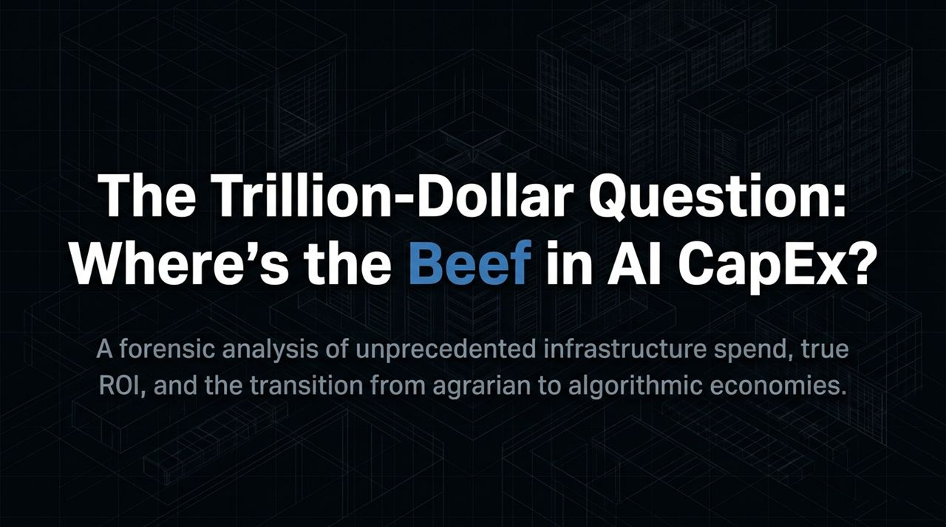
Notes:
Introduction & Opening Humor : Good morning, everyone. Welcome, and thank you all for traveling from across the globe to join us today. Before we dive into the numbers, I want to address something essential: how to be a global finance fitness influencer. First, abundant sweat—it establishes authenticity. Second, always elevate the camera angle to avoid the dreaded double chin. Third, shameless branding—wear logos like a NASCAR driver. Fourth, lean into the dorky dad vibes. And fifth, endless emojis to signal enthusiasm.
Transition to the Core Theme : Now, let's step into our day job. Today, we are addressing four vital macro questions: What has changed since we last met a year ago? What can we learn from history? Where do we stand today? And where is this economic wave carrying us?
The "Beef" Framing : We are examining all of this through the lens of two letters: AI. The central question being asked across global markets today is straightforward: "Where's the beef?" Trillions of dollars are flowing into infrastructure, chips, and power grids. Investors are naturally asking whether this buildout is supported by genuine, cash-on-cash ROI or if it's merely speculative fluff. Over the next several slides, we will demonstrate why the "beef"—the corporate returns, productivity expansion, and margin gains—is real and already showing up on balance sheets.
https://www.youtube.com/watch?v=4rhShOPHl50

Slide 2
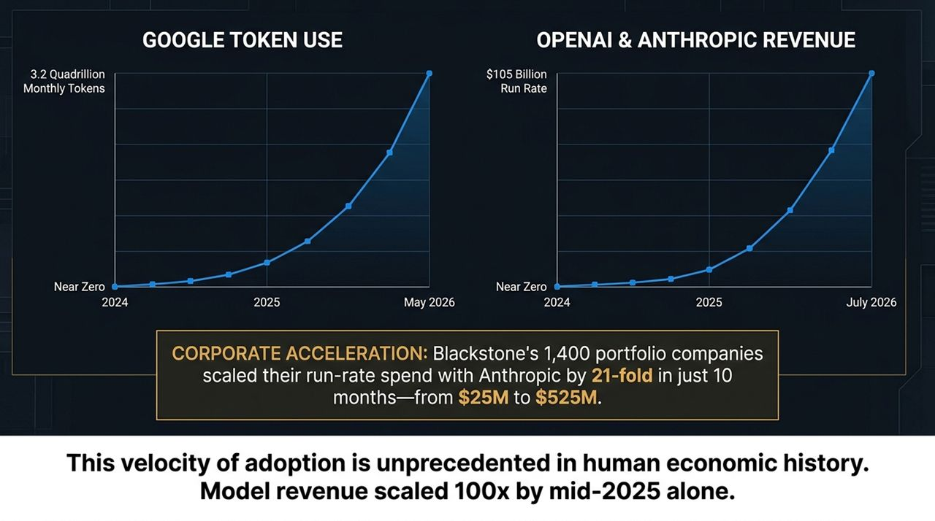
Notes:
Exponential Token Consumption : If we look back to September 2025, token usage was at hundreds of trillions. Fast-forward to May 2026, Google alone processed 3.2 quadrillion monthly tokens. This is an order of magnitude shift in compute consumption happening in less than eight quarters.
Model Revenue Run Rates : On the corporate side, frontier model companies like OpenAI and Anthropic generated virtually zero revenue a couple of years ago. By mid-2025, model revenues had scaled 100x, hitting an astounding $105 billion annualized run rate by July 2026. This speed of revenue adoption is completely unmatched in economic history.
The Proprietary Data Point (Blackstone Portfolio) : Skeptics often ask if this demand is artificially inflated or localized. Because of our scale at Blackstone, we have a unique window into real enterprise behavior. Across our network of 1,400 portfolio companies and borrowers, run-rate spending with Anthropic surged 21-fold in just 10 months—growing from $25 million in late 2025 to $525 million today.
Key Takeaway : Enterprises are not spending this money on a whim. They are pouring capital into these platforms because the software models are generating tangible, immediate returns for their core operations.

Slide 3
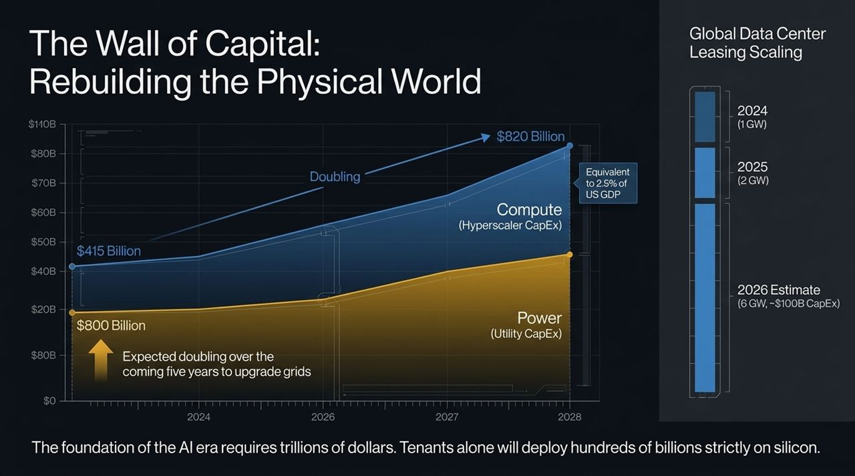
Notes:
Hyperscaler CapEx Expansion : To support this compute explosion, physical infrastructure spend is accelerating exponentially. Last year, hyperscaler CapEx across the top tech companies stood at $415 billion. By 2026, that number has virtually doubled to $820 billion. To put that into macro context, hyperscaler CapEx alone now equals approximately 2.5% of total US GDP.
Utility & Power Grid Upgrades : It’s not just tech firms spending money; utility CapEx is stepping up in parallel. Over the previous five years, global utility grid upgrades represented $800 billion. Over the next five years, that capital requirement is doubling as power grids worldwide are overhauled to feed energy-intensive data centers.
Data Center Leasing Footprint : Look at data center leasing velocity. In 2024, 1 Gigawatt was leased globally. In 2025, that doubled to 2 Gigawatts. In 2026, estimates point to 6 Gigawatts—representing ~$100 billion in direct data center CapEx, with tenants deploying hundreds of billions more strictly on silicon.
Key Takeaway : We are engaged in the largest physical infrastructure project of our lifetimes, bridging digital demand with real-world power and concrete.

Slide 4
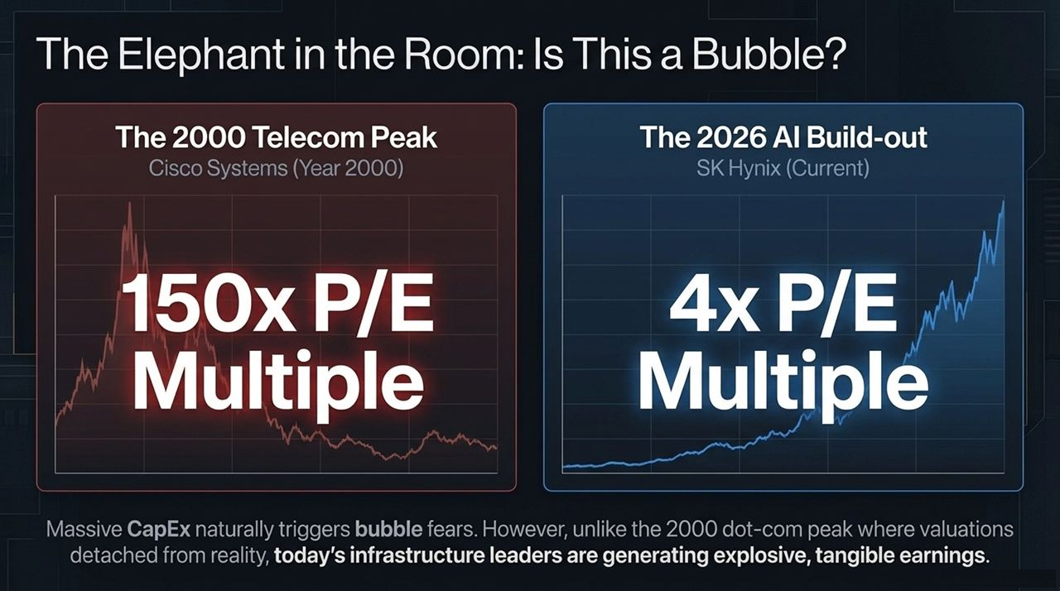
Notes:
Valuation Comparison (2000 vs. 2026) : Whenever investors see charts moving straight up, the immediate reaction is: "Is this the 2000 Dot-Com bubble all over again?" Let’s analyze the fundamentals. At the peak of the 2000 telecom boom, Cisco traded at a 150x Price-to-Earnings multiple based on speculative, uncontracted future buildout.
Current Earnings Reality : Today, primary hardware backbones like SK Hynix—whose stocks have risen 500% to 600% due to High-Bandwidth Memory demand—are trading at just a 4x P/E multiple. These companies are not valuing speculative dreams; they are printing massive, immediate, hard-cash earnings today.
Historical Lens (1870 to 1900 Transition) : Rather than looking at late-90s telecom, the true historical parallel is the late 19th-century transition from an Agrarian to an Industrial economy. In 1870, society relied on pitchforks, horses, wood structures, and candles. By 1900, steel structures, rail cars, and Edison’s electric grid had completely remade society.
Economic Impact of Electrification : During that 30-year period of physical rebuild, labor productivity doubled, national GDP quadrupled, manufacturing expanded 6x, and stock market values grew 7x. We are at the identical threshold today as we transition into an Algorithmic Economy.

Slide 5
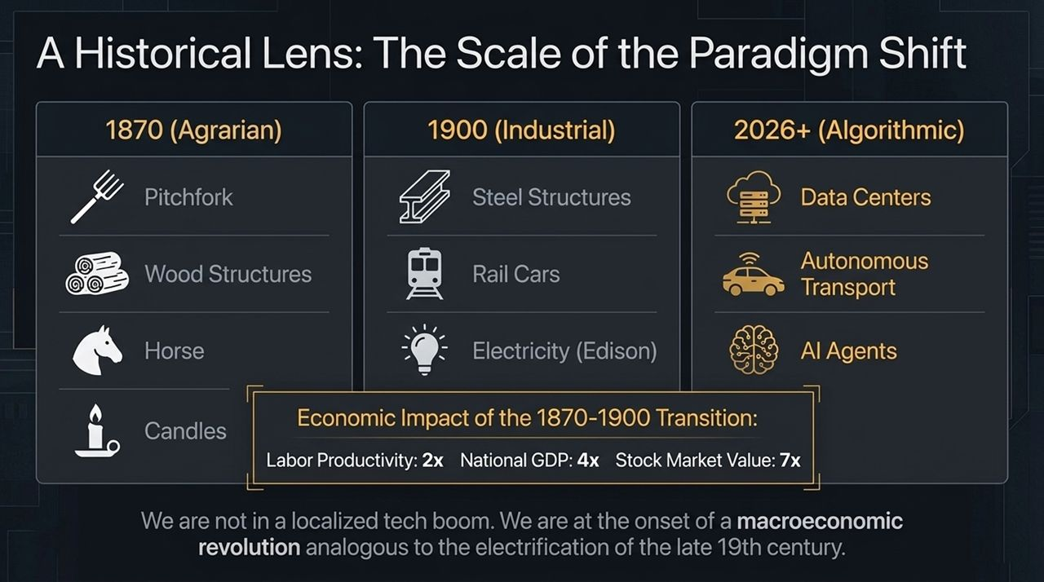
Notes:
The Cautionary Tale of Railroads & Telecom : During the 19th-century railroad boom, over 200 railroad companies went bankrupt. Why? Because they took on extreme leverage to build speculative supply far ahead of actual consumer demand. The 1990s telecom bust followed the exact same pattern.
The Structural Inversion of the AI Boom : Today, the dynamic is fundamentally inverted. Demand for compute and intelligence is running vastly ahead of available supply. Furthermore, the hyperscalers and data center operators building this infrastructure carry low financial leverage and enter into long-term, highly contracted revenue agreements before ground is broken.
Physical World Constraints : In software, you can spin up a microservice in seconds. In the physical world, transformers, power plants, and silicon fabrication plants take years to build. Physical reality permanently constrains supply from catching up with logarithmic intelligence demand, protecting pricing power across the infrastructure stack.

Slide 6
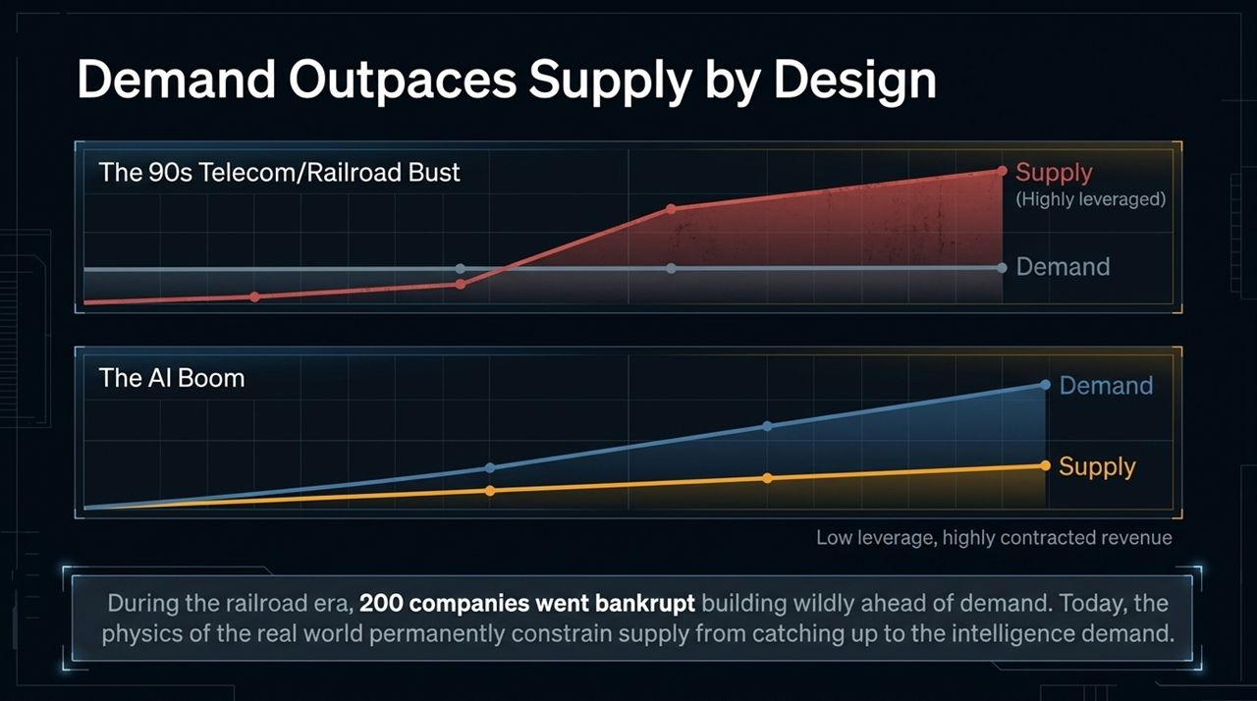
Notes:
1. Capital Requirements : Building an "AI Factory"—a fully integrated 1-Gigawatt compute campus with chips and dedicated power—requires approximately $55 billion per Gigawatt. Capital scale alone acts as a massive moat.
2. Entitlements & Zoning Delays : Local community moratoriums and strict zoning hurdles are creating major friction. We see community pushback and environmental restrictions right here in New York State and across Europe, heavily slowing down project approvals.
3. Power Generation Equipment Backlogs : If you want to buy new heavy-duty turbines from manufacturers like GE Vernova to power a data center campus, the current waitlist stretches out to 2030 or 2031. You simply cannot buy power equipment off the shelf.
4. Silicon Availability Imbalance : Over the last five years, hyperscaler CapEx demand has surged 9x. In response, core semiconductor supply has not even doubled. Chipmakers, accustomed to historic tech cycles, have been conservative, creating a structural deficit in available compute. Existing, operational compute capacity commands a high premium as a result.

Slide 7
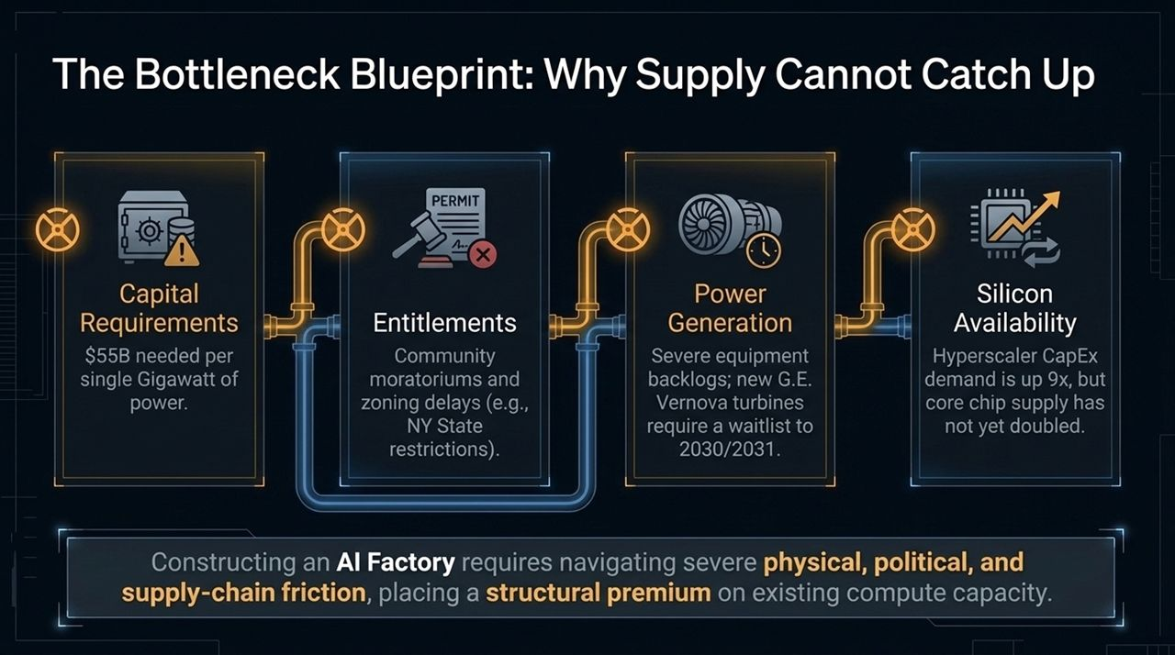
Notes:
The Infrastructure "Bun" vs. The ROI "Beef" : To understand this market, think of it like a burger. The "Bun" is the trillion-dollar foundation: the chips, data centers, cooling systems, and power grids. The "Beef"—what actually justifies the cost—is the software ROI, process speed, new revenue, and margin expansion.
Micro 'Beef' (Enterprise Case Studies) :
Process Automation: Phoenix Tower invested $4 million into AI leasing workflows; they now process leases 5x faster, generating $4.5 million in annual savings—a 100%+ annual return.
Software Engineering: Energy analytics firm Enverus deployed AI models to refactor legacy code, delivering an 18x cash return on every dollar spent with model companies.
Product Innovation: Chamberlain evolved from an analog garage door company to selling AI Face-Access smart locks, driving product run-rate from $50 million to a projected $500 million over five years.
Macro 'Beef' (National Metrics) :
Tech Sector: Hyperscaler revenue per employee surged 65% in 3.5 years.
Corporate Sector: S&P 500 and private portfolio EBITDA margins expanded 500 to 700 basis points over four years.
Macro Level: US annual productivity growth jumped from a 1.5% historical average to 2.6% over the last 30 months. Enterprise-level efficiencies are combining to lift overall economic output.

Slide 8
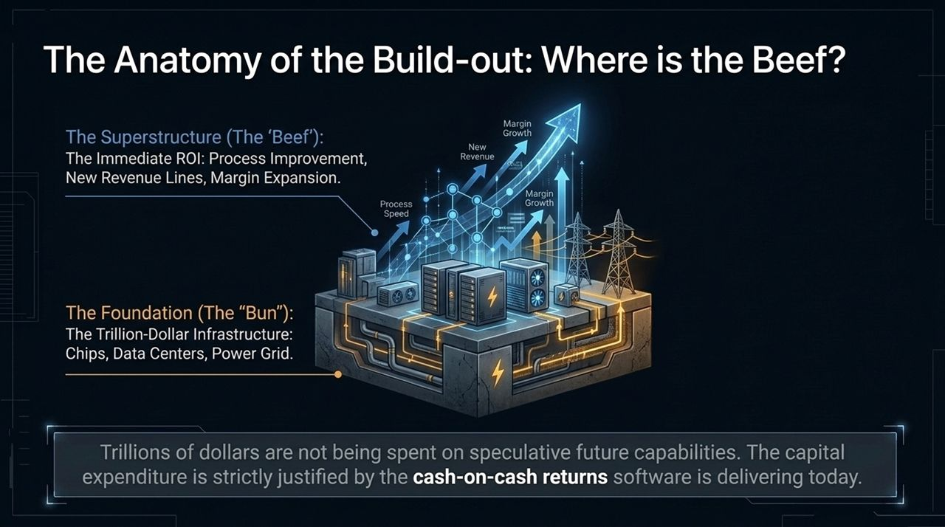
Notes:
Beyond the Desktop Chatbot : Most productivity gains to date have occurred at computer desks. However, the next exponential surge in compute demand will occur as AI moves into physical space, robotics, bioscience, and transportation.
Autonomous Transport : Waymo’s driverless autonomous mileage has expanded 250x in the last 2.5 years. More importantly, its safety metrics show a 94% reduction in serious injury accidents compared to human drivers. Autonomous logistics will require substantial real-time edge compute.
The Blue-Collar Infrastructure Boom : AI is not eliminating jobs wholesale; it is shifting labor needs. At QTS Data Centers, construction workforce requirements tripled in under two years to keep pace with physical buildout demands.
Bioscience & Pharmaceutical Chemistry : In life sciences, AI-assisted drug discovery is delivering real results. Clinical trial durations have dropped by up to 40% at platforms like Advara, while Phase 1 trial success rates are rising significantly.

Slide 9
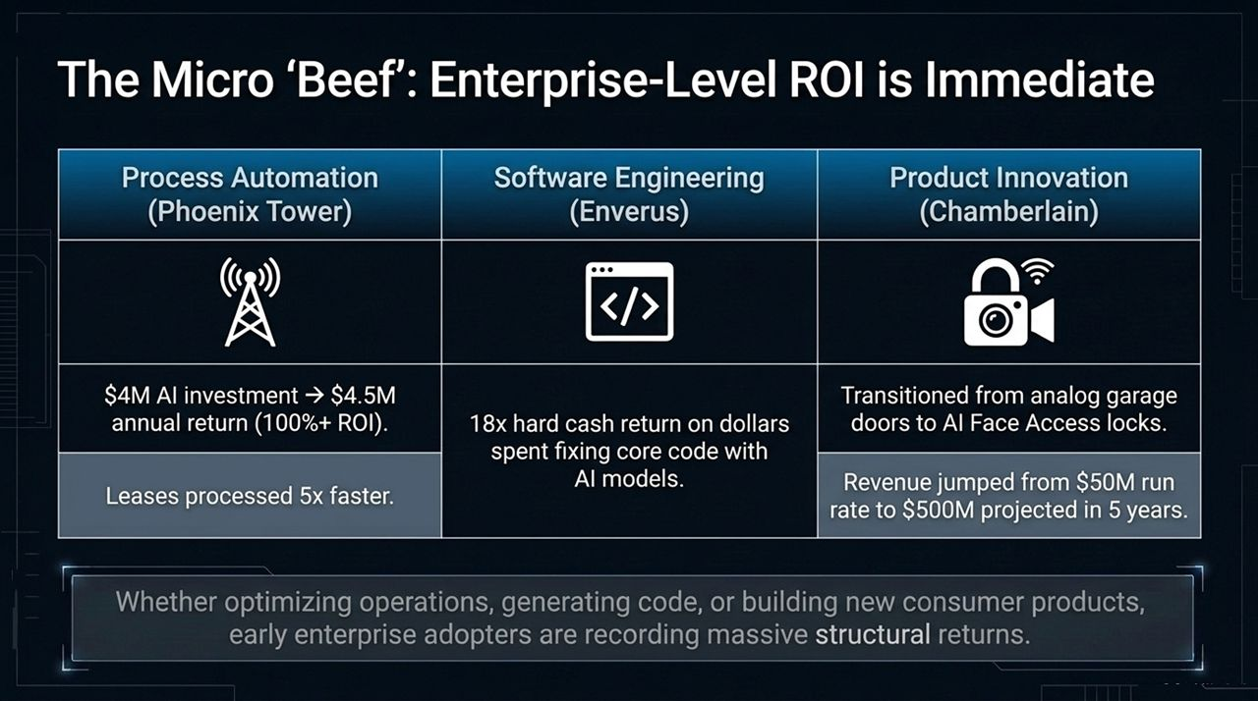
Notes:
Market Uncertainty & Multiple Compression : Over the past year, public software and professional services firms experienced notable stock multiple compression. Private equity software deal volume dropped 66% as investors grappled with fear of AI disruption.
Lessons from Retail Disruption : History shows us that technological shifts do not sink all incumbent ships equally. When e-commerce emerged, legacy retailers like Sears and Toys 'R' Us went bankrupt. However, Walmart, Costco, and TJ Maxx adapted, expanded their value propositions, and hit record profitability.
White-Collar Transition: "Selling Seats" vs. "Selling Outcomes" :
The Vulnerable: Businesses that rely on charging per-seat or billing manual human hours face multiple compression and potential obsolescence.
The Winners: Enterprise platforms that integrate AI directly into workflow systems of record and shift pricing models from "seats" to "outcomes delivered" will capture expanded margins.

Slide 10
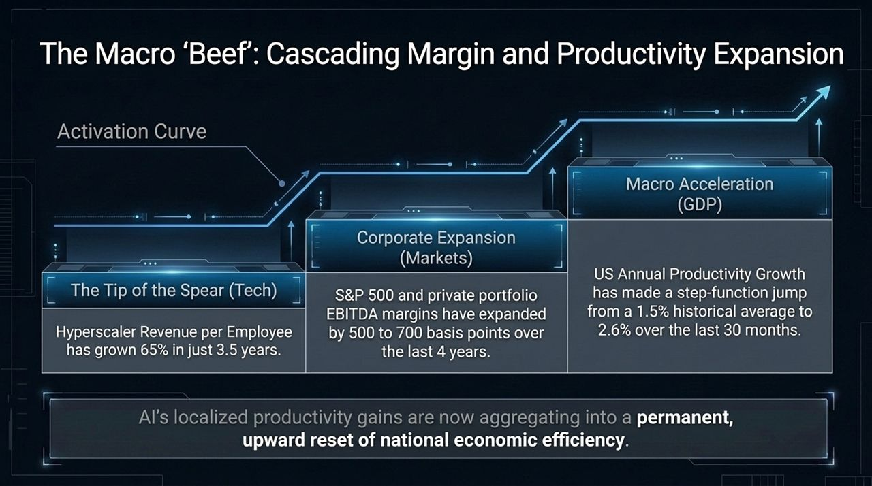
Notes:
Non-Disruptible Physical Assets : While software models evolve continuously, physical geography, irreproducible infrastructure, and human experiences cannot be replicated by algorithms.
Four Strategic Real-World Anchors :
Live Sports / Unique Media: Investing in an Indian Premier League cricket franchise—serving 1.4 billion passionate fans across only 10 sports licenses.
Irreplaceable Consumer Habits: High-margin, drive-thru beverage chains like Seven Brew catering to physical daily routines.
Geographical Scarcity: Prime beachfront real estate where supply is strictly fixed by physical geography.
Monopoly Physical Infrastructure: Critical hub assets like Rome Airport Terminal, providing vital physical gateways.
Strategic Portfolio Value : Combining digital infrastructure investments with low-multiple, cash-generative physical assets provides an effective portfolio hedge during rapid digitization.

Slide 11
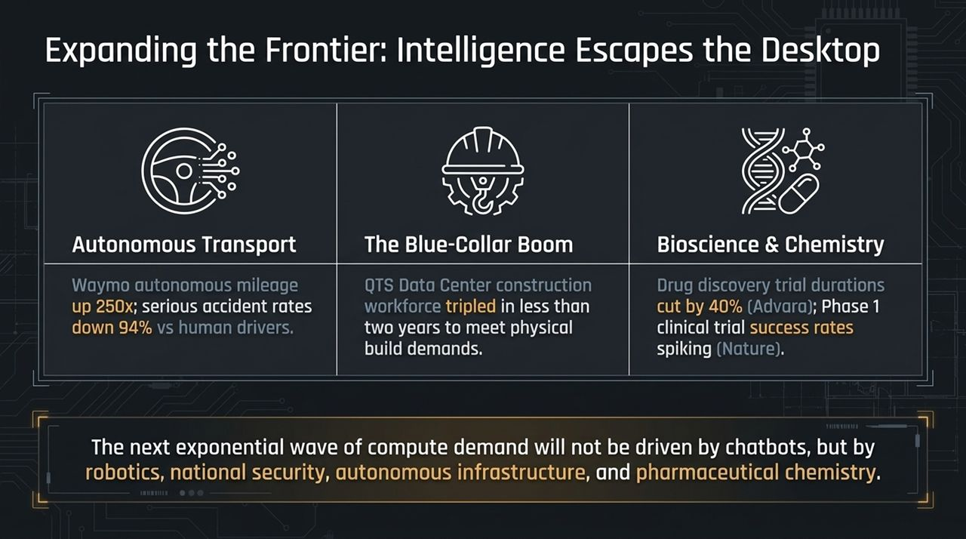
Notes:
Prudent Risk Management : While the broader adoption of AI is clear, executing at scale requires addressing four major structural risks:
1. Cyber Safety & Regulatory Friction : Sophisticated cyber threats against financial systems or energy grids could trigger heavy government intervention. Regulatory friction may slow down the outer frontier of model releases, though diffusion of existing models will continue.
2. Evolving Compute Tech (Space & Edge) : Tech evolutions—such as space-based solar data centers or edge processing on handheld devices—could alter terrestrial data center demand. However, given the steep demand curve, ground-based facilities will remain foundational for the foreseeable future.
3. Geopolitical Supply Chain Concentration : Over 90% of advanced semiconductor manufacturing is concentrated in Taiwan. Any geopolitical disruption in the Taiwan Strait presents an immediate supply chain risk to global technology.
4. Speculative Venture Valuations : Early-stage, pre-revenue defense and AI startups seeking $10B+ valuations demand rigorous investment discipline to avoid overpaying for hype.

Slide 12
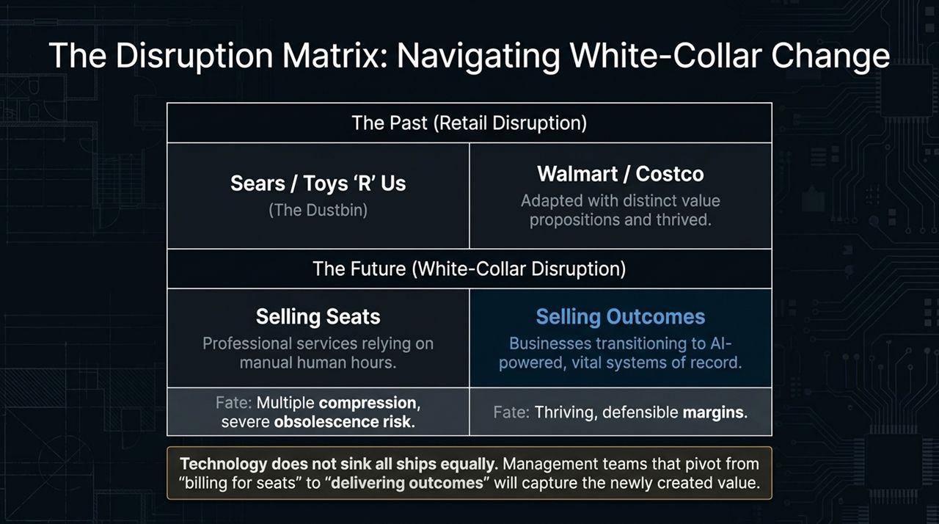
Notes:
Focusing on the Senior-Most Layers : Given these macro uncertainties, our primary strategy is to focus capital deployment on the senior-most, foundational layers of the compute stack—power, land, grid access, and core data center facilities.
Guaranteed Structural Demand : Downstream software applications may face competition, but every application requires underlying power and compute.
Preserving Pricing Power : Because real-world constraints—such as turbine backlogs, chip lead times, and power grid bottlenecks—restrict supply, operational infrastructure assets maintain strong pricing power.
Conclusion : This CapEx expansion is not an uncalculated risk. It is a structured response to clear economic returns. The "beef" is real, software yields are strong, and foundational infrastructure sits at the center of this transformation.

Slide 13
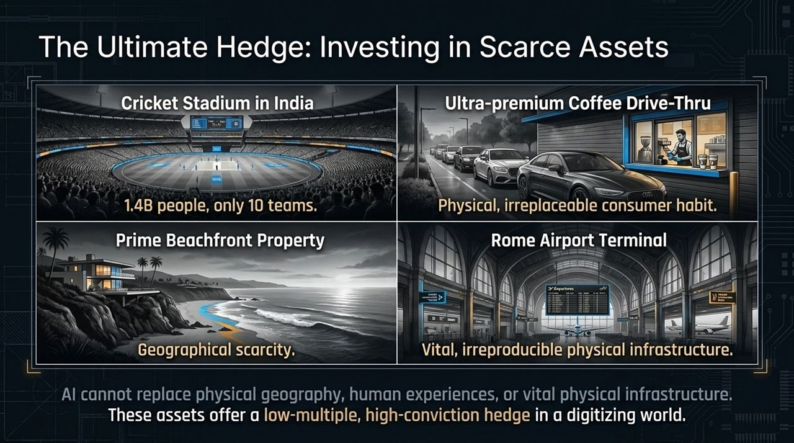
Notes:
Visualizing the Physical Stack : Slide 13 brings us to the visual illustration of our macro framework. Here, we look closely at the Infrastructure "Bun"—the physical foundation absorbing hundreds of billions in capital.
The Expansion of Token Demand : The graphic highlights the massive pipeline scaling from 400 Trillion Tokens in 2024 to Quadrillions by 2026. To accommodate this, data centers have transformed from localized server rooms into industrial energy plants.
Macro Capital Scale : Spending by top tech firms doubled in a single year, reaching 2.5% of US GDP. This visual represents why data centers are now analyzed like heavy utilities rather than traditional real estate.

Slide 14
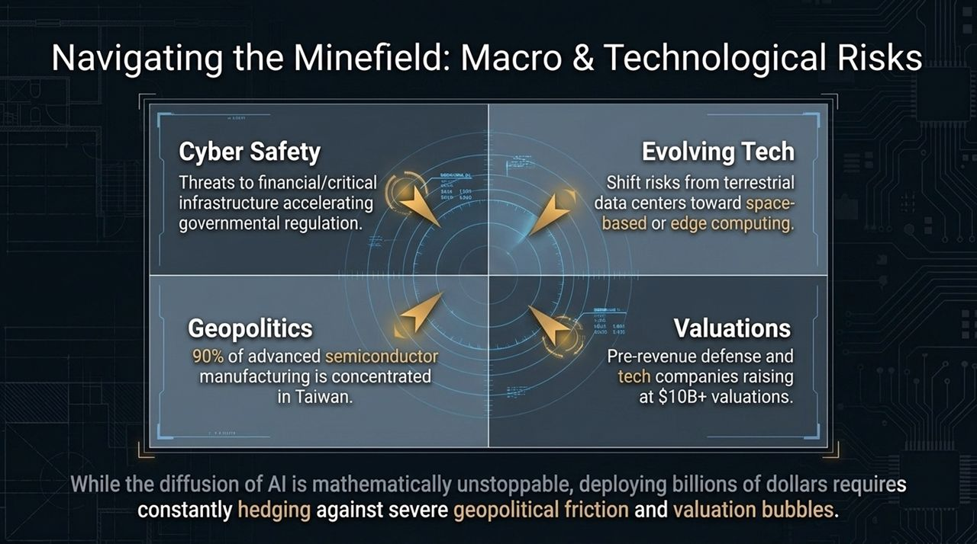
Notes:
The Valve Metaphor : This slide illustrates the central constraint in the AI ecosystem: the physical bottleneck. Think of digital intelligence as pressurized water flowing through a pipe, restricted by a physical manifold valve.
The Three Critical Friction Points :
Power Grid Capacity: Local utilities cannot upgrade high-voltage lines quickly enough.
Data Center Entitlements: Zoning restrictions and local moratoriums slow down site preparation.
Chip Availability: Advanced silicon supply remains tightly constrained relative to hyperscaler demand.
Strategic Takeaway : Capital invested in solving these specific bottlenecks secures long-term value because these physical assets cannot be bypassed by software alone.

Slide 15
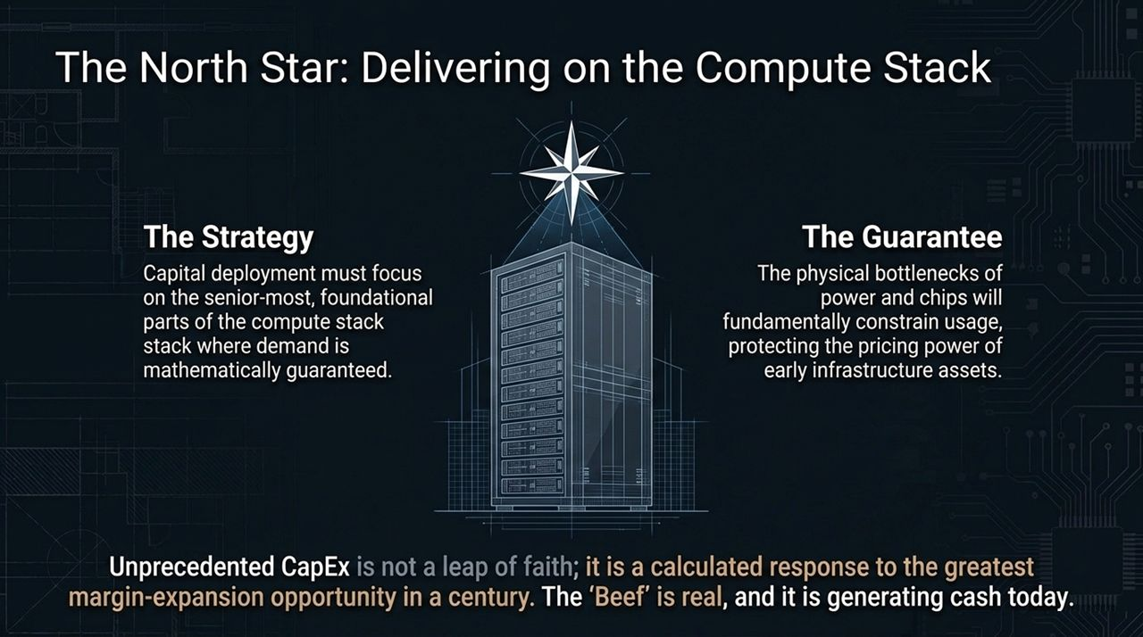
Notes:
Quantifying Surge to 2.6%: Broad macroeconomic data shows US labor productivity nearly doubling from its decade average of 1.5% to 2.6% over the lastEnterprise Yields : Here, we focus on concrete enterprise metrics:
100%+ Annual Returns on Process AI: Illustrated by Phoenix Tower’s 5x faster lease processing on a $4M investment.
18x Cash Returns on Code Remediations: Verified across software engineering portfolios like Enverus.
US Productivity 30 months.
Summary : These metrics demonstrate that current CapEx is grounded in clear operational productivity and margin gains.

Slide 16
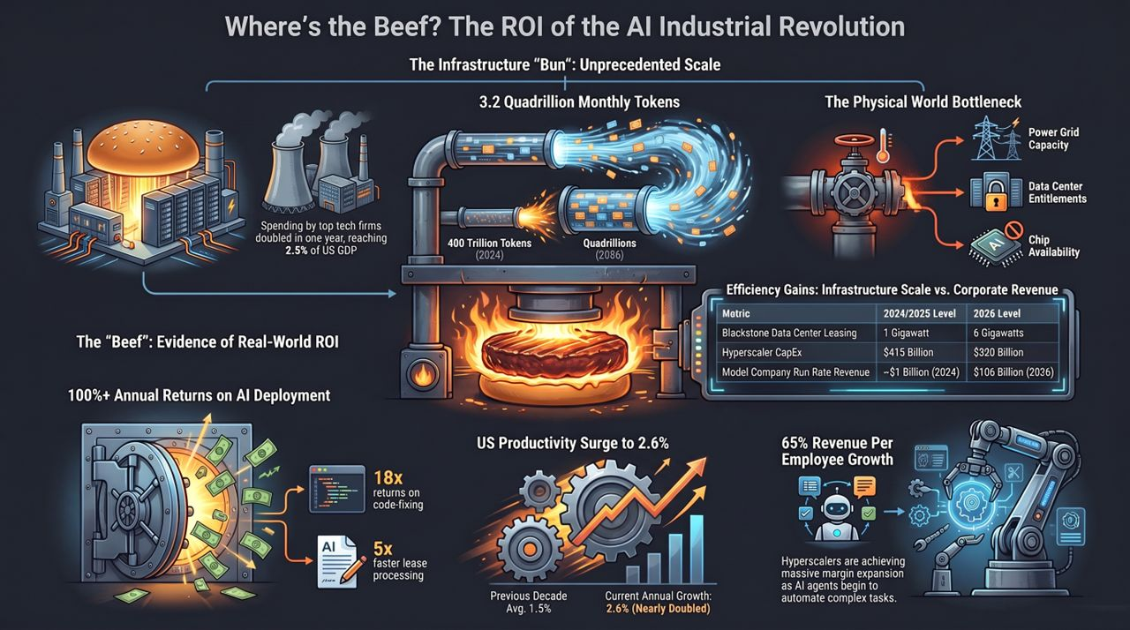
Notes:
Comparative Performance Summary Table :
Data Center Leasing Footprint: Scaled from 1 GW in 2024 to 6 GW in 2026.
Hyperscaler CapEx: Expanded from $415 Billion to $820 Billion.
Model Company Run-Rate Revenue: Surged from ~$1 Billion in 2024 to $105 Billion in 2026.
Revenue Per Employee Step-Function : Hyperscalers have driven 65% growth in Revenue Per Employee over a 3.5-year period. As AI agents transition from handling simple queries to managing complex, multi-step workflows, corporate operating leverage continues to expand.
Closing Thoughts : We remain focused on delivering durable returns for our investors by anchoring capital in the core infrastructure supporting this economic shift. Thank you all very much.
https://www.youtube.com/watch?v=4rhShOPHl50

